Slide 1

CPE 490 Embedded Systems Lecture 16
FreeRTOS Implementation
Much of this presentation comes from www.freertos.org tutorial
As well as “Using the FreeRTOS Real Time Kernal, A Practical Guide”, Richard Barry, 2010 version 1.3.2.

Slide 2
Senior Moment #1
Are not two sparrows sold for a penny? And not one of them will fall to the ground apart from your Father. But even the hairs of your head are all numbered. Fear not, therefore; you are of more value than many sparrows. Matt 10:29-31 (ESV)
God cares and will show up in every aspect of your engineering career.

Slide 3
Senior Moment #2
Think about building a ‘portfolio’ for interviewing
Be prepared to talk in detail about a significant engineering accomplishment on an interview
It is important that you show ownership and mastery of project.

Slide 4
Senior Moment #2
Coursework is fine, but we are more interested in seeing what you have built and how you have built it. – Marc Raibert, Co-founder and President, Boston Dynamics Boeing prefers to hire students with demonstrated experience in their field, either through outside coursework, an internship or a relevant project while in school. – Pamela R. Simpson, Vice President of Human Resources for Engineering, Operations, and Technology, Boeing
Notes:
See other tips on what I sent out earlier

Slide 5
Defining and Creating Tasks in FreeRTOS
Define Task
Create Task #1
Create Task #2

Slide 6
User Written Task function
Prototype:
void ATaskFunction( void *pvParameters);
Example
void ATaskFunction(void *pvParameters)
{
int iVariableExample = 0;
for ( ; ;)
{
//code implementation goes here
}
vTaskDelete( NULL );
}
Notes:
The prototype must be followed, in that the function can return nothing and the there is only one void pointer as a parameter (this could give you access to many variable).
You can declare variables in the function as normal but you can not declare an variable static. The reason is that you could create more than one instances of the task function when create API is used (more on this later).
A task is normally implemented as an infinite loop it will hog the processor until it at interrupt tick it is preempted or it puts itself asleep, by blocking (more on this later). Do not put a return statement into this code.
It a task should ever exit the for loop then it must destroy itself before the task returns.

Slide 7
Creating (Spawn) a Task
Prototype:
portBase_Type xTaskCreate(
pdTASK_CODE pvTaskCode,
const signed char * const pcName,
unsigned short usStackDepth,
void *pvParameters,
unsigned portBASE_TYPE uxPriority,
xTaskHandle *pxCreatedTask
);
Notes:
pvTaskCode – a pointer to the function that implements the task see previous slid it would be a pointer to ATaskFunction.
pcName is a string that describes the task, this is not used by the kernel and is used for debugging purposes only
usStackDepth is a an integer (16 bits) that describes the stack size, in words (16 bits) that will be reserved for this instance of the task. This is a guess but the minimum size declared in the demo is 105 bytes. In reality you will take a guess and then use given tools to track the stack usage.
pvParameters the task function does have this parameter in its input list you can use this pointer to make the correct instance of the task. This just initializes function because it will only be called once.
uxPriority this gives the priority of the task in our case the priority starts a zero and goes up to 3 so when creating a task the priority should be 1,2, or 3.
pxCreated Task is used to pass a handle to the kernal to an integer that will be assigned by the task creator, you then can use this handle in other API function calls like delete a task.
Return value is an integer either pdTRUE (this is an integer 1) or errCOULD_NOT_ALLOCATE_REQUIRED_MEMORY = -1
Types
portBASE_TYPE: Defined as the most efficient data type for the architecture (for dsPIC33 that would be 16 bit or integer.

Slide 8
Example Make 2 Instances of the Task
static const char *pcTextForTask1 = “Task 1 is running \r\n”;
static const char *pcTextForTask2 = “Task 2 is running \r\n”;
int main( void ) {
xTaskCreate( vTaskFunction, “TSK 1”, 1000, (void*) pcTestForTask1, 1, null);
xTaskCreate( vTaskFunction, “TSK 2”, 1000, (void*) pcTestForTask2, 1, null);
vTaskStartScheduler();
for( ; ; );
}
Notes:
In this main code we create 2 instances of the same task but by feeding different char string we will print two different messages.
It is important that these strings are permanent so they are declared static const, I believe we could get away with just making them const with our compiler
Each task function is defined by vTaskFunction, they have different dbug tags, the same 1000 byte stack space (most likely way too big), the string passed to the function (notice how the char pointer is cast to be void pointer), with priority level 1, and finally no handle is passed.
The for loop is only if VTaskStartScheduler would fail because of the lack of resources, so if you end up trapped in the for loop you know something has gone wrong. Missing and it could be a good idea is to check the return value from xTaskCreate to make sure that a task was created.

Slide 9
Example Declare a Task
void vTaskFunction( void *pvParameters)
{
char *pcTaskName;
volatile unsigned long ul;
pcTaskName = ( char * ) pvParameters;
for ( ; ; ) {
vPrintString(pcTaskName);
for ( ul = 0; ul < mainDelay_Loop_Count; ul++)
{
}
}
}
Notes:
This follows the prototype we just saw
The pvParameters is a void pointer, we cast it to be a character pointer and then use it print out a string.
The infinite loop is proper for a task as we discussed
The for loop is a delay, that is very inefficient.

Slide 10
Continuous Processing Tasks
They never block them selves (more in this later)
Rule: If the lowest priority is 0 and a continuous process tasks has a non zero positive integer value of X then all priorities less than X will never run.

Slide 11
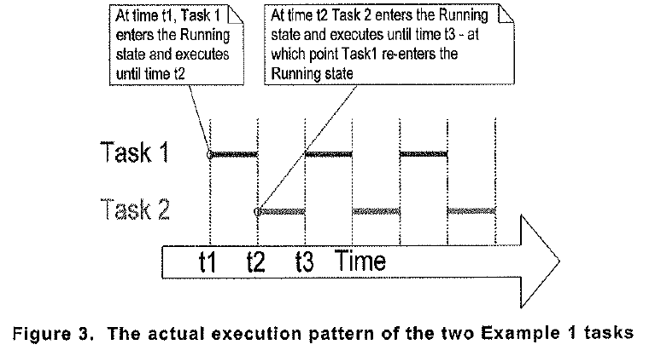
Example Timing Diagram
Notes:
Both of the tasks are examples of continuous tasks that is they never are blocked waiting for an event. These tasks will continue to run, never letting a task at priority 0 (the idle task) to run.

Slide 12
Tick Interrupt
To be able to select the next task to run, the scheduler itself must execute at the end of each time slice.
A periodic interrupt called the tick interrupt is created this is how the scheduler runs at the end of each time slice
The tick interrupt frequency is defined as configTICK_RATE_HZ while the period in milliseconds is defined as portTICK_RATE_MS
The tick count is the total number of tick interrupts. Tasks don’t worry about roll over as it is already taken care of in the kernel.
Notes:
In the demo program for the dsPIC the frequency is set at 1000 Hz or every 1 ms. ConfigTICK_RATE_HZ is defined FREERTOSCONFIG.h

Slide 13
Tick Interrupt Frequency Tradeoff
The higher the frequency the less efficient the code that is the interrupt latency becomes are greater percentage of run time of the processor
The lower the frequency to the lower the resolution of control. Pre-emptive task switching can only happen at the tick interrupt.

Slide 14
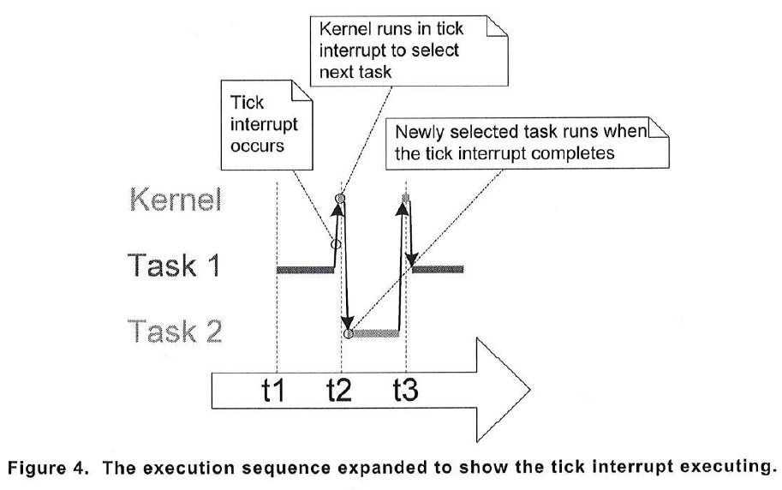
Graphical Example of Tick Interrupt

Slide 15
Starving a Task
If task 2 has a higher priority then task 1 and task 2 is continuous task it will never relinquish control to task 1.
In this case task 2 starves task 1. We can see that it would be good if task 2 could go to sleep or be blocked for a period of time or until an event occurs.

Slide 16
Blocked State
A task that is waiting for an event is said to be in the blocked state, a subset of the not running state,
A task can be waiting for two different types of events:
Time related event, periodic or absolute time
Synchronization event that originates from another task or an interrupt. These events are communicated through queues, and semaphores.
The task puts itself into the blocked state

Slide 17
Suspended State
A task is suspended through an API call:
vTaskSuspend( xTaskHandle pxTaskToSuspend)
The only way it can come out of suspension is to make an API call:
vTaskResume(xTaskHandle pxTaskToResume)
Most application do not use the suspend state
Notes:
The pxTaskToSuspend is created when a pointer is given in the taskcreate call

Slide 18
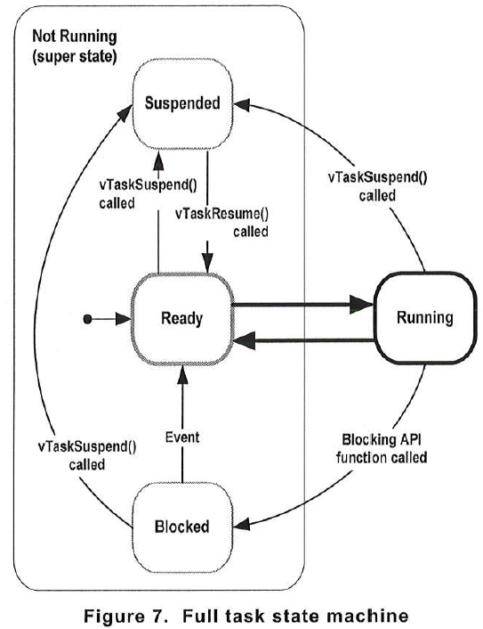
Task State Machine

Slide 19
Time Delays Using APIs
There are two different API function calls to block a task.
vTaskDelay
vTaskDelayUntil

Slide 20
vTaskDelay()
Prototype
Void vTaskDelay( portTickType xTicksToDelay);
Where xTicksToDelay is the number of tick interrupts that the calling task should remain in the blocked state before going back to the ready sate
Notes:
This is an absolute delay from the time that it is called.

Slide 21
Example Task Using Blocking State
void vTaskFunction( void *pvParameters ) {
char *pcTaskName;
pcTaskName = (char *) pvParameters;
for ( ; ; ) {
vPrintString( pcTaskName );
vTaskDelay( 250 / portTICK_RATE_MS );
}
}
Notes:
portTICK_RATE_MS is going to be the number of milliseconds per one clock tick. The delay will be for 250 ms. Therefore this task will be blocked for 250 ms.

Slide 22
vTaskDelayUntil()
This is used when we want a task to be called periodically.
It will record the current tick time when the API is unblocked and apply the time delay to this time. In this way the time it takes to execute the task is not a factor.
Notes:
The other delay will only occur from moment you block and can not promise periodic behavior unless the code run time is always exactly the same.

Slide 23
vTaskDelayUntil()
void vTaskDelay”Until( portTickType * pxPreviousWakeTime, portTickType xTimeIncrement);
pxPreviousWakeTime is the time tick accumulated count when the task was called.
xTimeIncrement is an integer that sets the period of periodic calling of the task. Its units are time ticks

Slide 24
void vTaskFunction( void *pvParameters )
{
char *pcTaskname;
portTickType xLastWakeTime;
pcTaskName = ( char * ) pvParameters;
/* The xLastWakeTime variable needs to be initialized with the current tick count. Note that this is the only time the variable is written to explicitly. After this xLastWakeTime is updated automatically internally within vTaskDelayUntil(). */
xLastWakeTime = xTaksGetTickCount();
/* As per most tasks, this task is implemented in an infinite loop. */
for( ;; )
{
/* Print out the name of the task. */
vPrintString( pcTaskNAme );
/* This task should execute exactly every 250 ms. As per the VTaskDelay() function, time is measured in ticks, and the portTICK_RATE_MS constant is used to convert milliseconds into ticks. xLastWakeTime is automatically updated within vTaskDelayUntil() so is not explicitly updated by the task. */
vTaskDelayUntil( &xLastWakeTime, (250 / port_TICK_RATE_MS);
}
}

Slide 25
Example Task Creation Using Blocking State
static const char *pcTextForTask1 = “Task 1 is running \r\n”;
static const char *pcTextForTask2 = “Task 2 is running \r\n”;
int main( void ) {
xTaskCreate( vTaskFunction, “TSK 1”, 1000, (void*) pcTestForTask1, 1, null);
xTaskCreate( vTaskFunction, “TSK 2”, 1000, (void*) pcTestForTask2, 2, null);
vTaskStartScheduler();
for( ; ; );
}
Notes:
In this case we made two instances of the task. Task 1 has a priority of 1 while Task 2 has a priority of 2. If the delay was not done by blocking task 1 would never run because task 2 would starve it. But since task 2 can now be blocked this opens time for task1 to run and since both tasks can be blocked the idle task will also run.

Slide 26
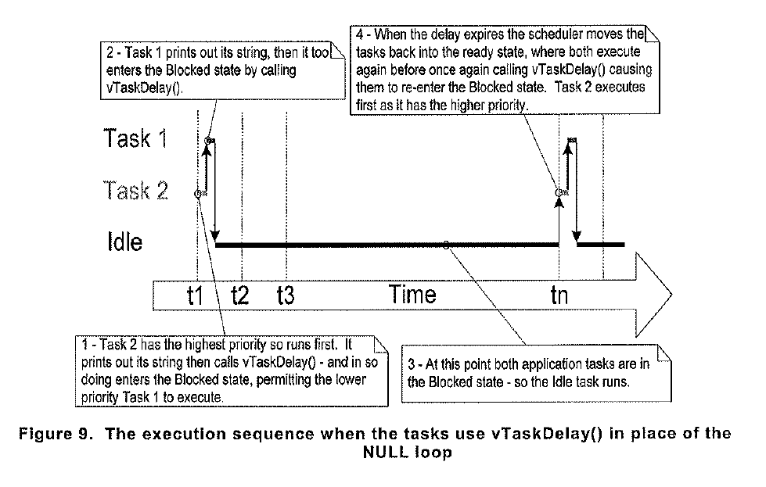
Timing Diagram

